Slide 1
PoC Data Analysis Output
Daniel Riddick

Slide 2
Desired Output
The desired output within the final analysis is to have a user interface where the user can search for a research term and is presented with table output of the most impactful researchers and their affiliations within that subject area of interest.
The pilot application that will be presented will likely have a drop-down menu containing specific research areas of interest, due API limitations from the data source, Web of Science.

Slide 3
Data Utilized
The data utilized within this PoC were 500 publications from the Web of Science in a Bibtex format in order to include references.
The data was initially filtered to exclude international publications, publications older than 5 years, journal articles only, and the English language only.
The data was then fed through a bibliographic analysis by using the Rstudio bibliographix package.

Slide 4
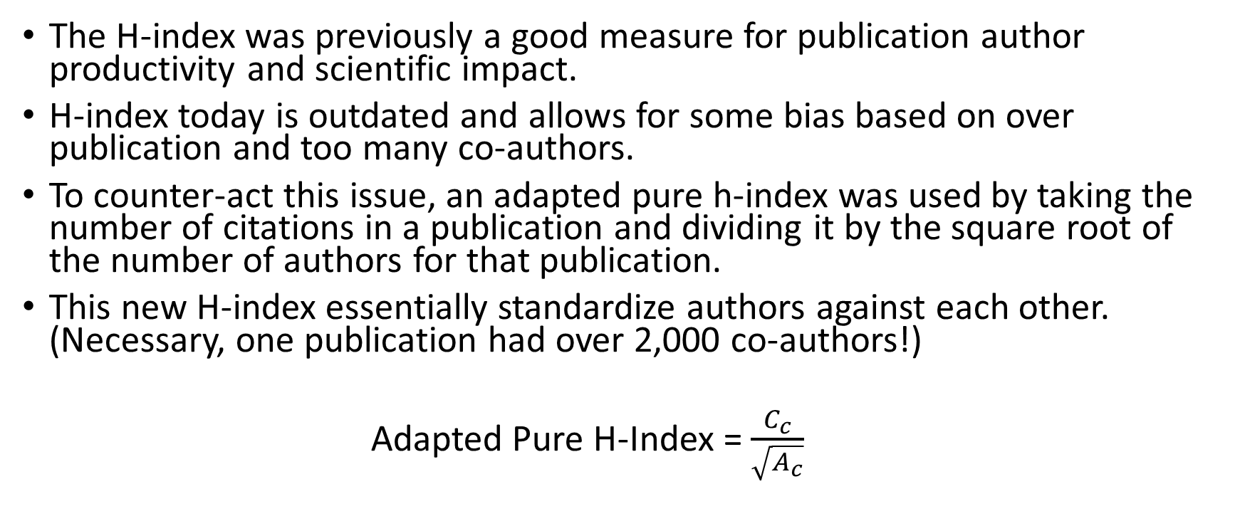
Analytical Steps for Adapted Pure H-index
The H-index was previously a good measure for publication author productivity and scientific impact.
H-index today is outdated and allows for some bias based on over publication and too many co-authors.
To counter-act this issue, an adapted pure h-index was used by taking the number of citations in a publication and dividing it by the square root of the number of authors for that publication.
This new H-index essentially standardize authors against each other. (Necessary, one publication had over 2,000 co-authors!)
Adapted Pure H-Index = $\frac{C_{c}}{\sqrt{A_{c}}}$

Slide 5
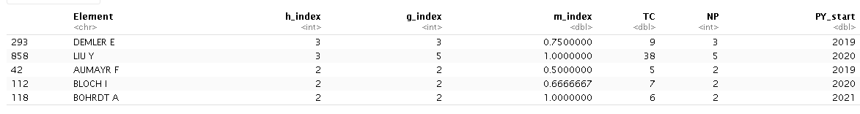
Adapted Pure H-index Output
Below is the output from the adapted pure H-index calculation for the top 5 authors. Higher H-index scores indicate more scientific production and quality within their field.
Authors are denoted as, “Element”, the higher H-index scores indicate authors of high interest within this specific subject area.

Slide 6
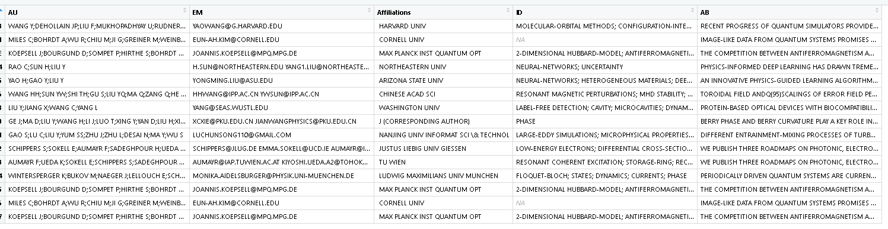
Results
The output below shows a portion of the data frame that was constructed based on the adapted pure H-index output seen previously. These are all publications the authors shown previously have been affiliated with.
It represent the top 5 authors, their publications, affiliations, abstract of publication, related keywords, and related email to the publication.
Emails related to the publications are singular, meaning that contact about their publication may be subject to data on-hand. (EM)

Slide 7
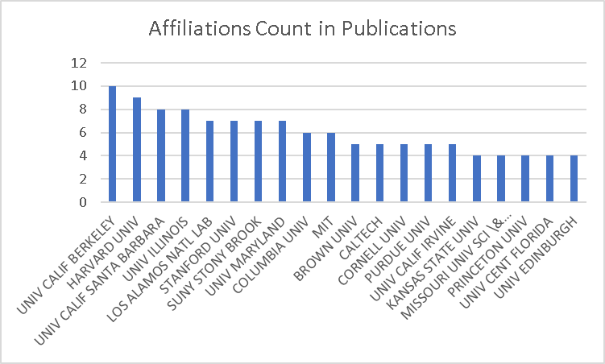
Affiliations Results
The plot at right shows the most common affiliations related to this specific research subject of interest, theoretical physics.
The plot shows the frequency of times these organizations were associated with publications in this subject.

Slide 8
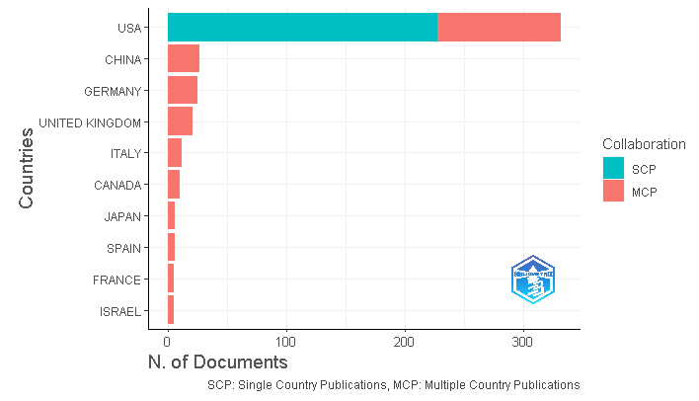
Data Verification
International Documents
As shown in the graph there are still some international publications despite filtering on Web of Science.
This is due to multiple countries collaborating on a single publication and will be resolved during the data validation portion of this project.

Slide 9
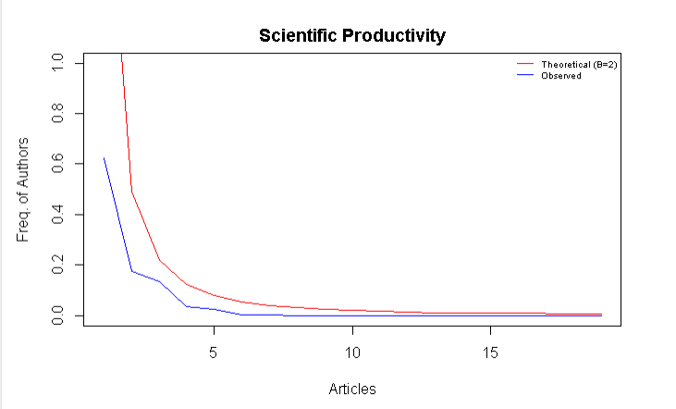
Lotka’s Law Coefficient Estimation
Lotka’s law describes the frequency of publication by authors in any given field as an inverse square law, where the number of authors publishing a certain number of articles is a fixed ratio to the number of authors publishing a single article. This assumption implies that the theoretical beta coefficient of Lotka’s law is equal to 2.
In layman’s terms, Lotka’s Law essentially measures the expected frequency of authors and their number of publications vs. the observed frequency of authors and their number of publications.
It is a good measure for observing overall bias within the data

Slide 10

Next Step, Data Validation
Data needs to be verified as being similar to the research subject area of interest. (Sampling Method)
1
Multiple country publications need to be removed from future data
2
Data construction using multiple keywords and merging is to be performed for use in the end tool.
3

